Slide 1

COVID-19
Chandramohan Jha
Amity University Chhattisgarh

Slide 2
During COVID-19, doctors and all medical staffs are facing great burden. It is a great challenges for us to make our medical staffs burden free so that they can work with their full potential. And India as the second most populated country there is great challenges prevent our health care system from collapsing.

Slide 3
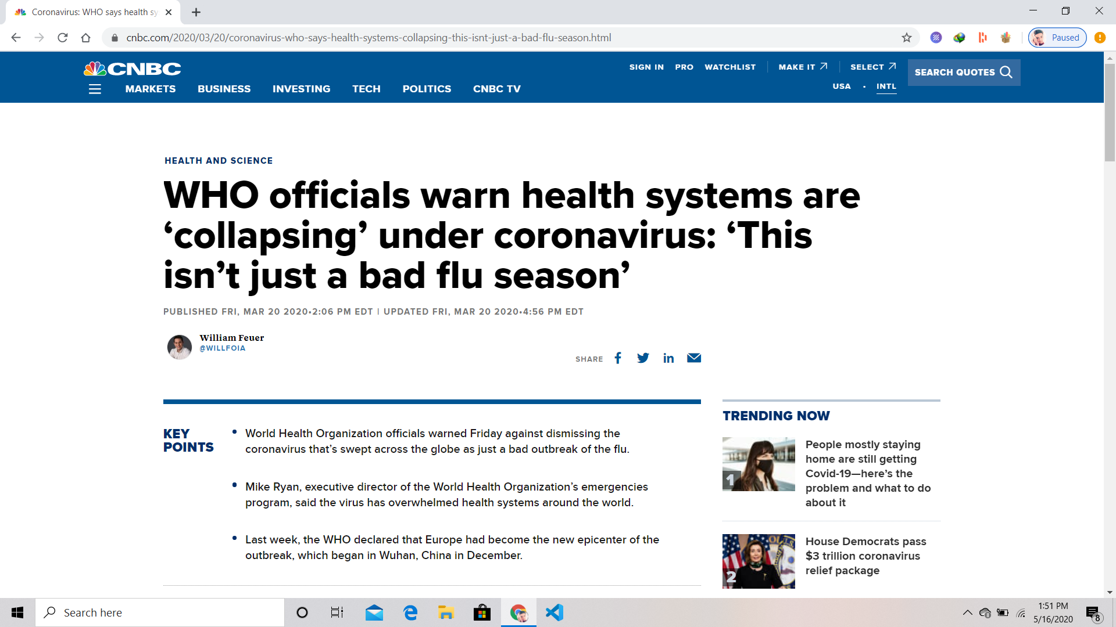
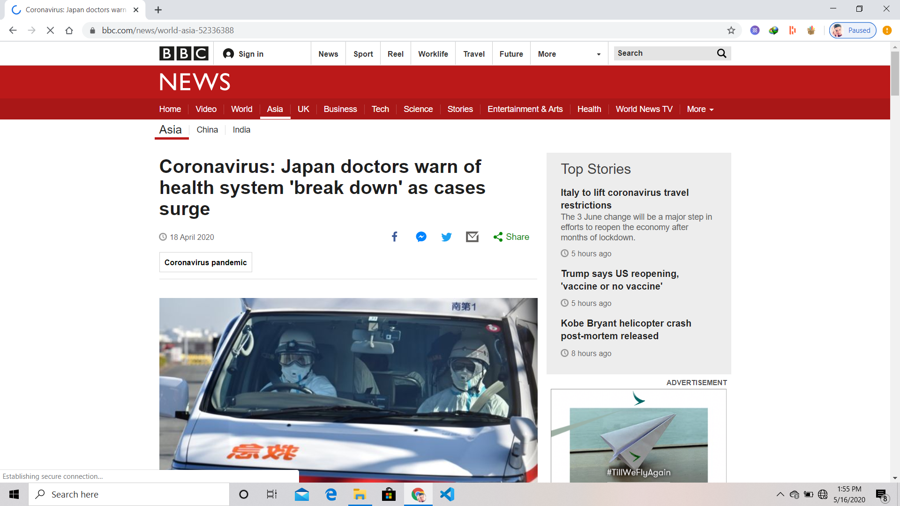

Slide 4
MAYBE YOU NEED TO DIVIDE THE TEXT
PEOPLE
SURFACES
This disease can spread from person to person through small droplets from the nose or the mouth when the infected person coughs or exhales
These small droplets land on surfaces, which means any person that touches these surfaces and then their eyes, nose or mouth can become infected

Slide 5
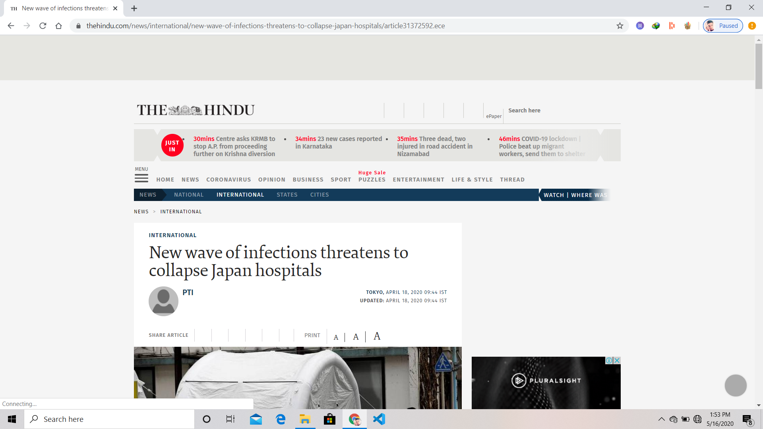
INFOGRAPHICS
TIREDNESS
HIGH FEVER
The body feels completely tired, without energy
The body temperature can exceed 37.3 Celsius degrees
DRY COUGH
DIFFICULTY BREATHING
Constant coughing without expelling any mucus
Breathing actually feels more difficult

Slide 6
My Idea
We collects the parameters like on which factor the chance of being affected by covid-19 is high. Like age, runny nose, fever, difficulty in breathing etc.
And according to this factor we can train our machine learning model and deploy it by using flask.
If suspected persons come to checkup, through their symptoms we can find the probability of being affected by covid-19 and according to this we can give priority to them.

Slide 7
Thank you

